Slide 1


Supervised Learning

Slide 2

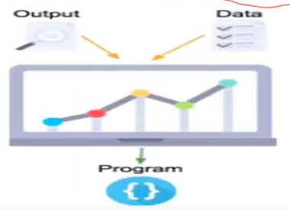
Supervised Learning

Slide 3
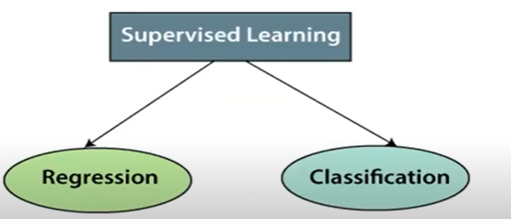
Types of Supervised Learning

Slide 4
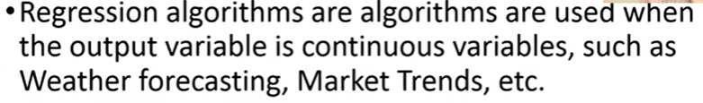
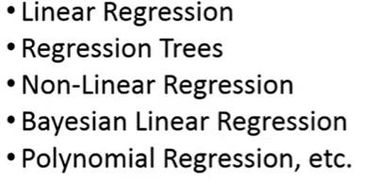
Regression

Slide 5
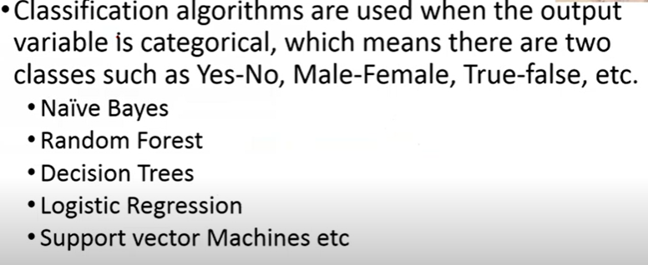
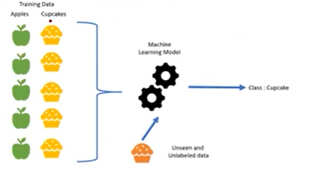
Classification

Slide 6

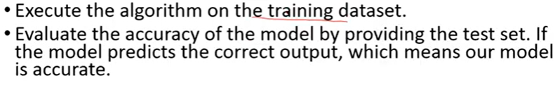
How Supervised Learning Algorithm works

Slide 7
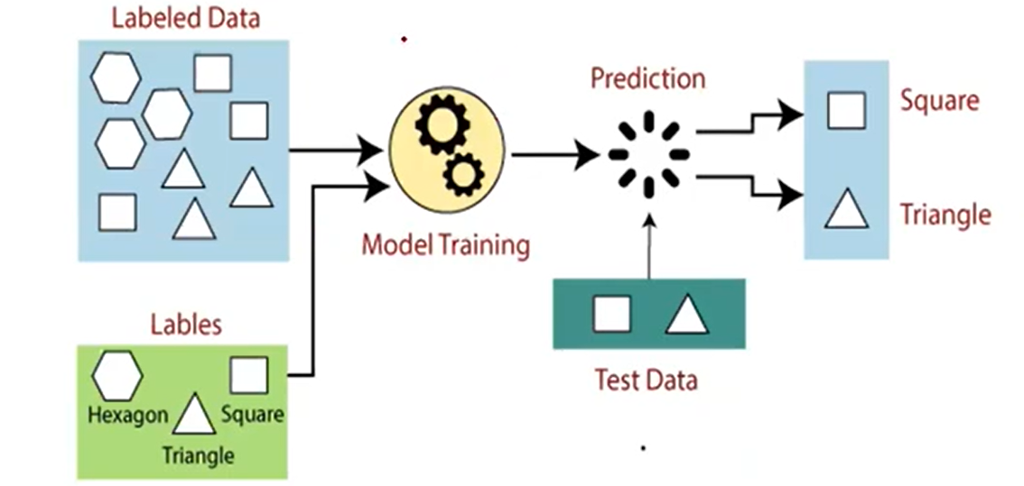
How Supervised Learning Algorithm works

Slide 8
Evaluate classification and regression predictions
Classification predictions can be evaluated using accuracy, whereas regression predictions cannot.
Regression predictions can be evaluated using root mean squared error, whereas classification predictions cannot.

Slide 9
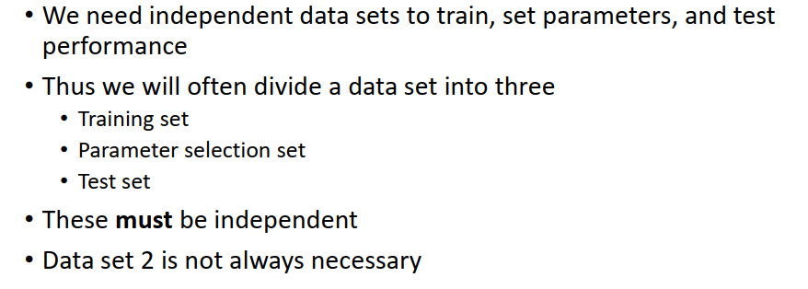
Splitting of Training and test Data

Slide 10
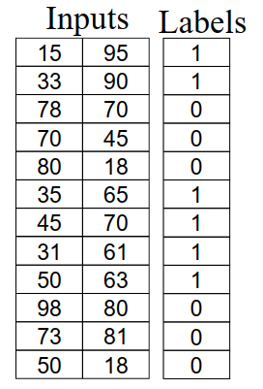
Dataset

Slide 11
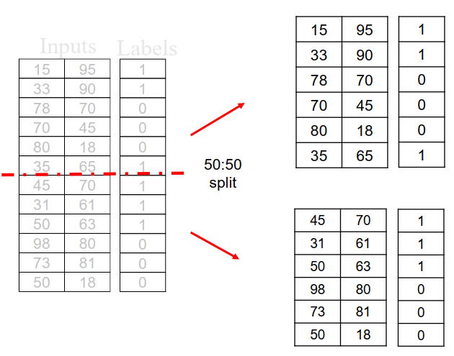

Slide 12
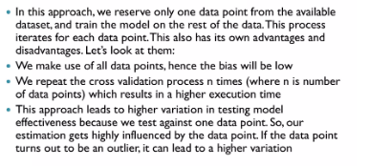
Leave One Out Cross Validation

Slide 13
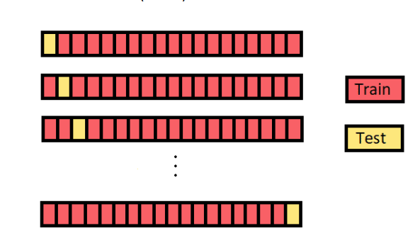
LOOCV

Slide 14
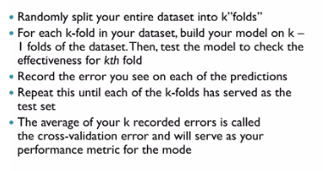
K-Fold Cross validation

Slide 15
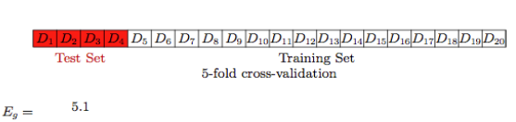
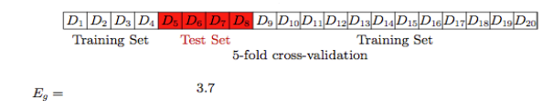
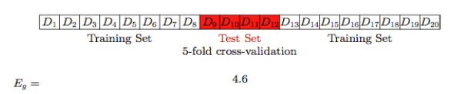
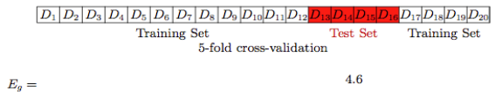
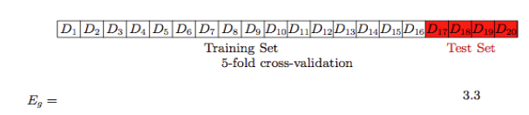

Slide 16
K Nearest Neighbor Classification

Slide 17
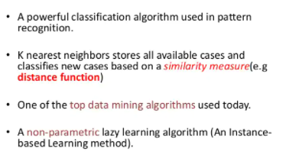
K Nearest Neighbor Classification (lazy Learner)

Slide 18
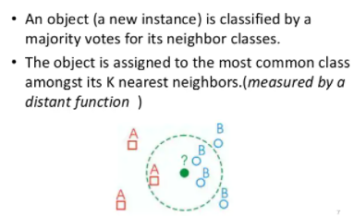
KNN Classification Approach

Slide 19
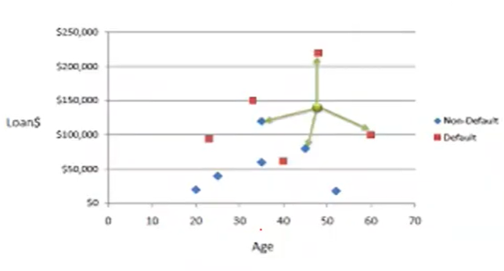
KNN Classification Approach

Slide 20
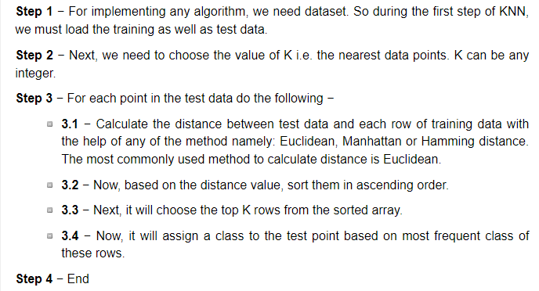
KNN Classification Algorithm

Slide 21
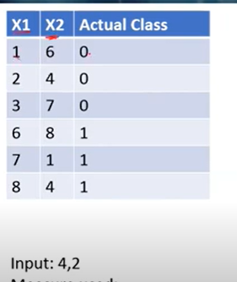
KNN Classification Algorithm –
example
Manhattan Dist | K=1 | K=3 | K=5
|1-4|+||6-2| =7
|2-4|+||4-2| =4
|3-4|+||7-2| =6
|6-4|+||8-2| =8
|7-4|+||1-2| =4
|8-4|+||4-2| =6

Slide 22
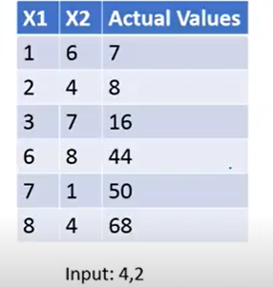
KNN Regression- Example
Manhattan Dist
|1-4|+||6-2| =7
|2-4|+||4-2| =4
|3-4|+||7-2| =6
|6-4|+||8-2| =8
|7-4|+||1-2| =4
|8-4|+||4-2| =6
K=1 | K=3
(8+50)/2=29 | (8+16=50=68)/4=

Slide 23
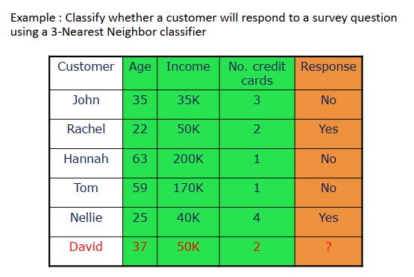
KNN - Example

Slide 24
Picking K
Use N fold cross validation – Pick K to minimize the cross validation error
For each of N training example
Find its K nearest neighbours
Make a classification based on these K neighbours
Calculate classification error
Output average error over all examples
Use the K that gives lowest average error over the N training examples

Slide 25
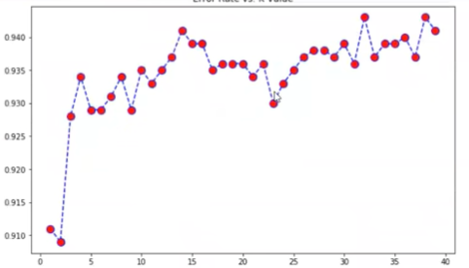
Picking K

Slide 26
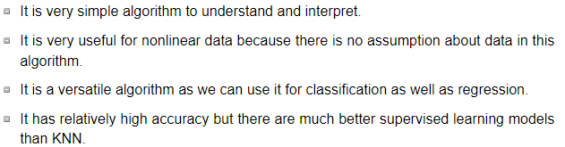
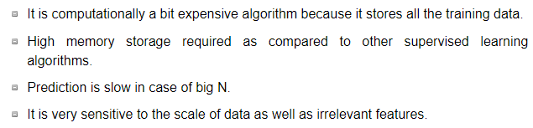
Pros and Cons of KNN
Pros
Cons

Slide 27
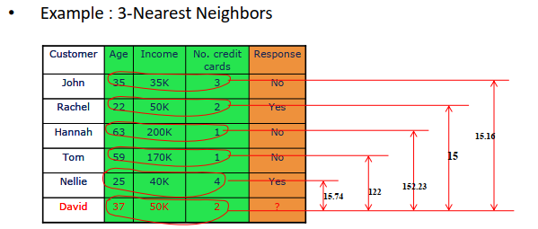
KNN - Example
Some of the above calculated values are wrong.

